Slide 1
THE NUMBERS.COM
BOT DATA EXTRACTION, 1000 MOVIES ANALYSIS
BY: DIVYAM BAJAJ

Slide 2

Objective of the Project
To analyze a dataset of over 1,000 movies based on IMDb ratings, worldwide box office performance, and profitability, examining various factors such as genre, profit margin, sources, production methods, production companies, and directors.

Slide 3
Workflow Overview
3 days
data collection
2 days
Structuring and transformation
1 day
visualization,
1 day
analysis, providing a comprehensive approach

Slide 4
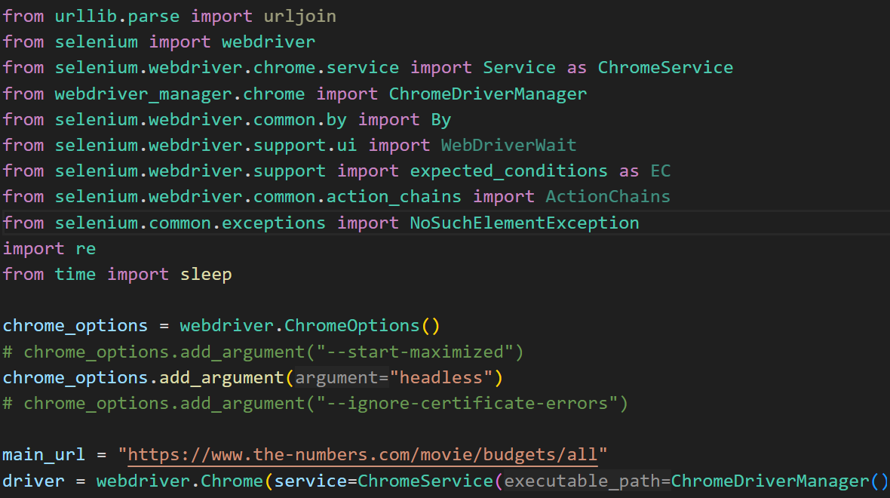
Data Collection Process
A Selenium bot was developed to extract data from The-Numbers.com, effectively navigating complex HTML structures across multiple pages to collect data on at least 1,000 movies.

Slide 5
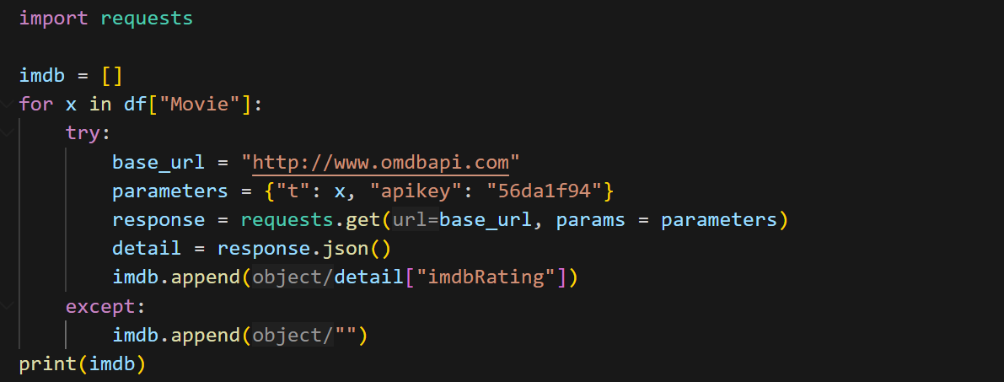
Retrieving IMDb Ratings
IMDb ratings were retrieved via API calls using a search method to match titles, which were then integrated into the main dataset for analysis.

Slide 6
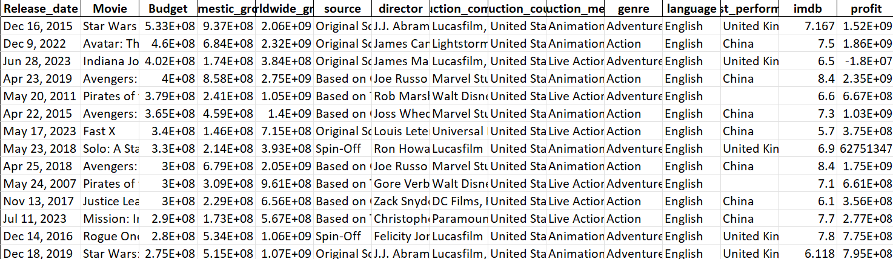
Data Structuring Techniques
Data was organized into dataframes using Pandas and NumPy arrays, preparing the dataset for thorough analysis and visualization.

Slide 7
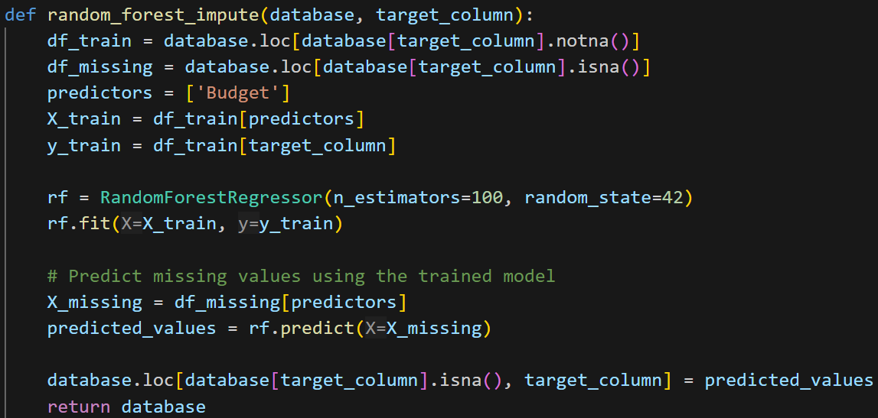
Missing Data Transformation
Missing values were addressed using Random Forest prediction, while regex was employed to convert special characters (e.g., "$") to numerical data, ensuring data integrity.

Slide 8
Data Visualization Tools
Using Matplotlib, Seaborn, and Power BI, various visuals were created, including:
Histogram: Distribution of IMDb ratings.
Correlation Matrix: Analyzing IMDb and profit by genre.
Bar Graphs: Worldwide gross by genre and performance by production method.
Line Chart: Top-performing countries by earnings.
Map: Geographic distribution of top-performing countries, genres, and production companies.
Pie & Donut Charts: Relationship between genres and sources.
Box Plot: IMDb ratings by genre and source.
Bubble and Table Charts: Movie distribution by genre, source, and rating.

Slide 9
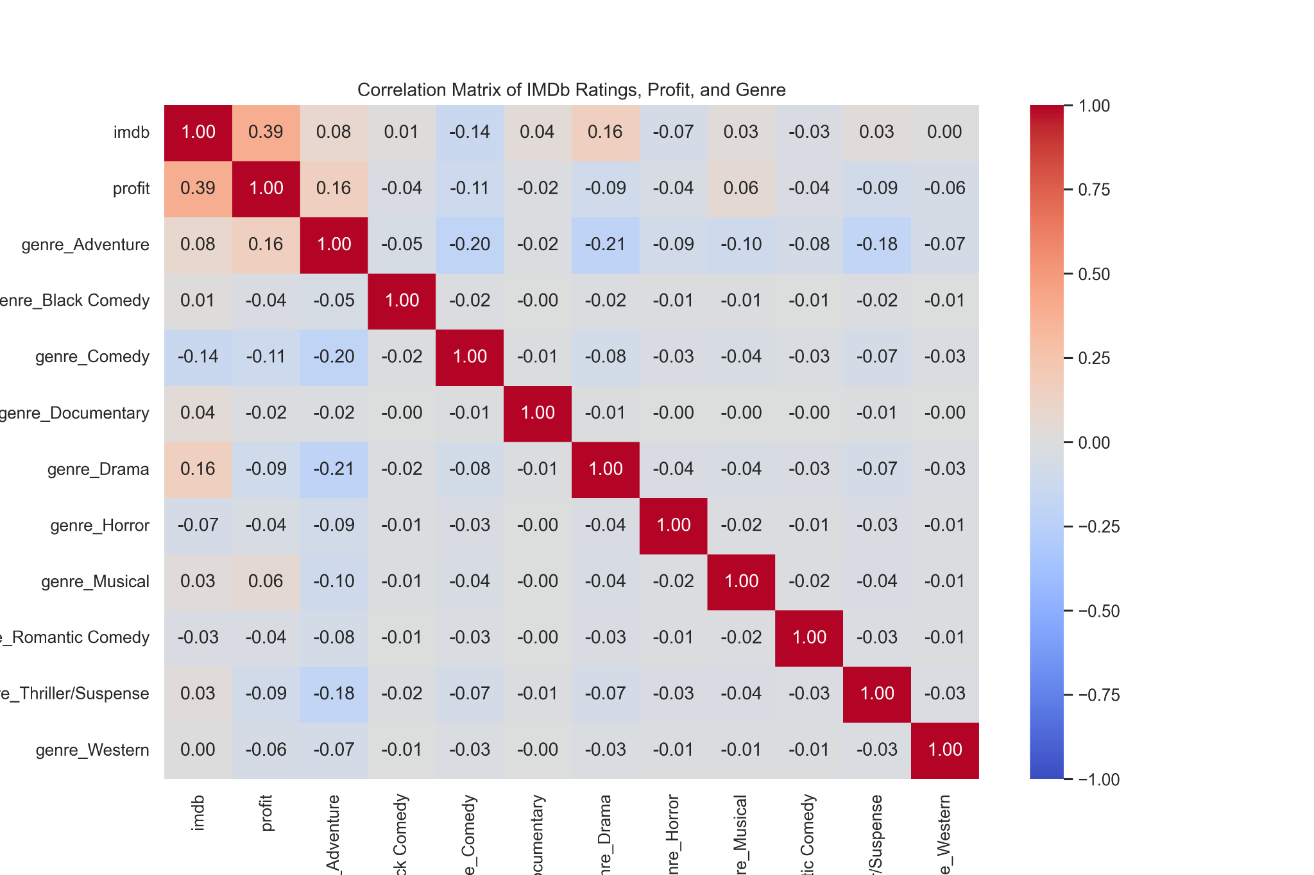
Correlation Matrix: Analyzing IMDb and profit by genre.

Slide 10
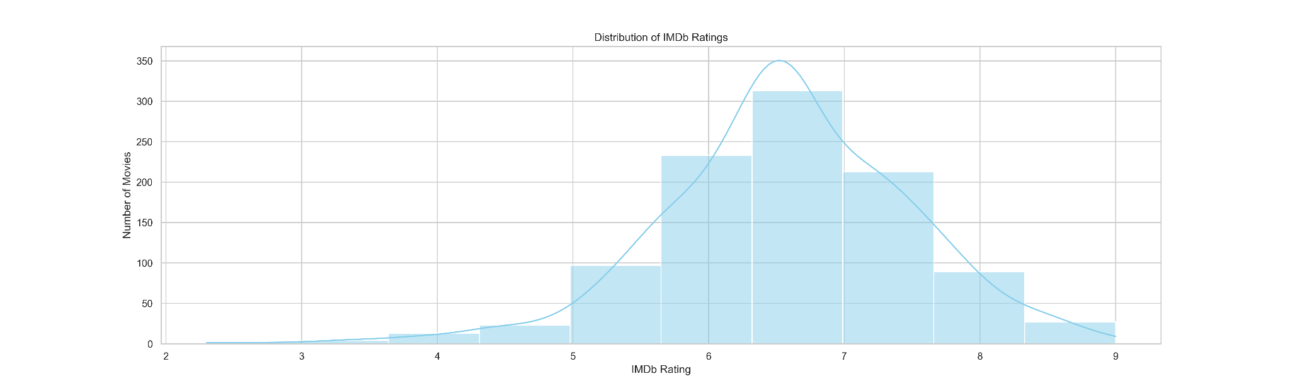
Histogram: Distribution of IMDb ratings.

Slide 11
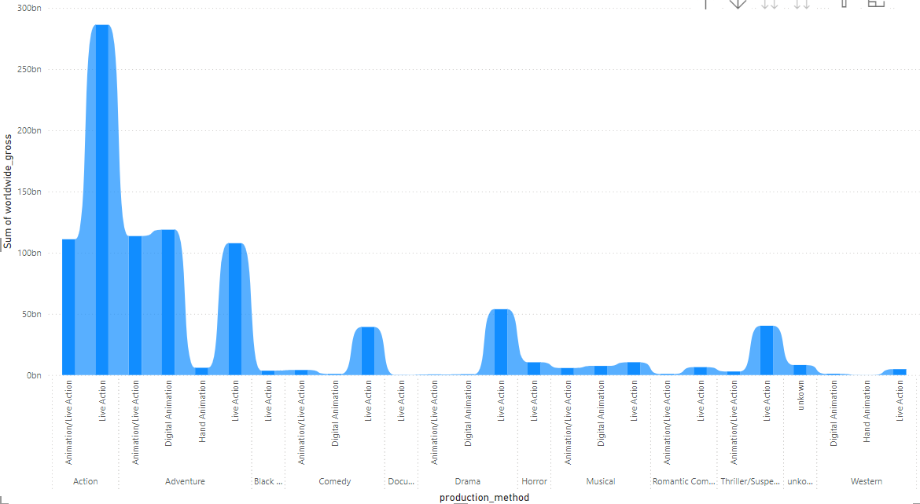
Bar Graphs: Worldwide gross by genre and performance by production method.

Slide 12
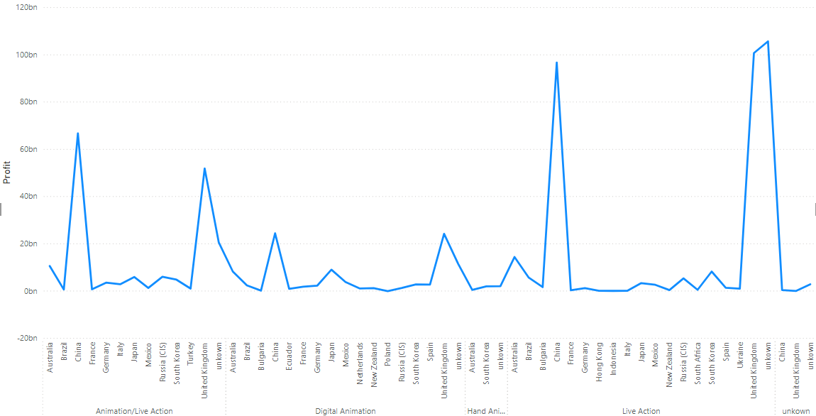
Line Chart: Top-performing countries by earnings.

Slide 13
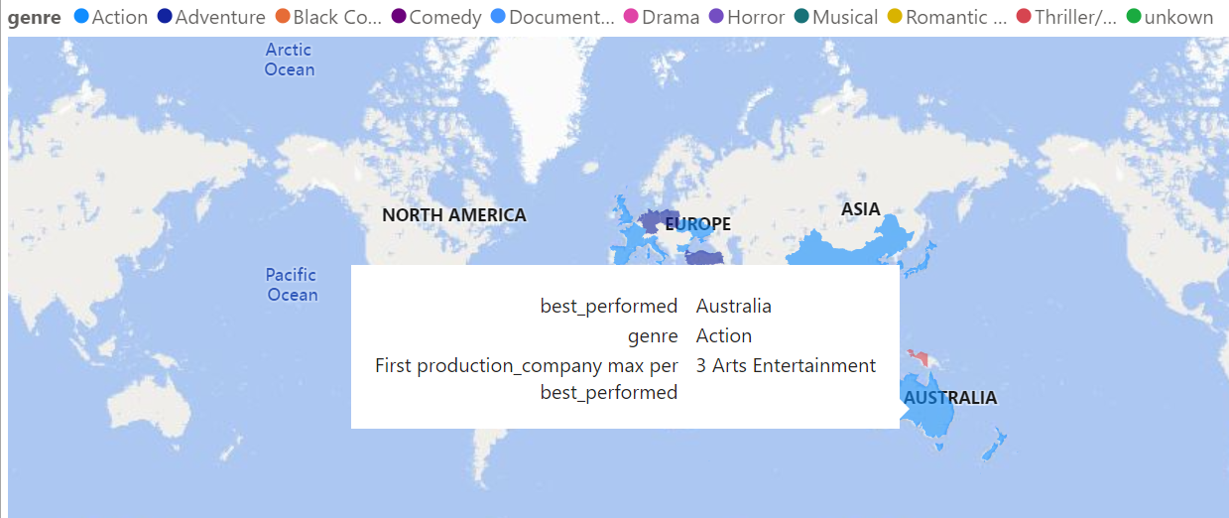
Map: Geographic distribution of top-performing countries, genres, and production companies.

Slide 14
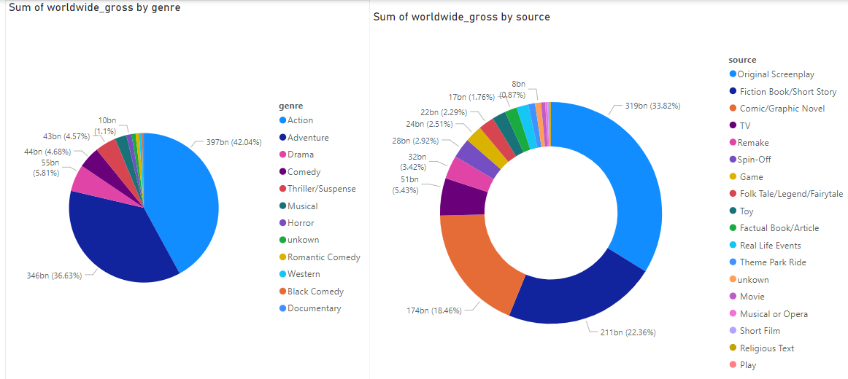
Pie & Donut Charts: Relationship between genres and sources.

Slide 15
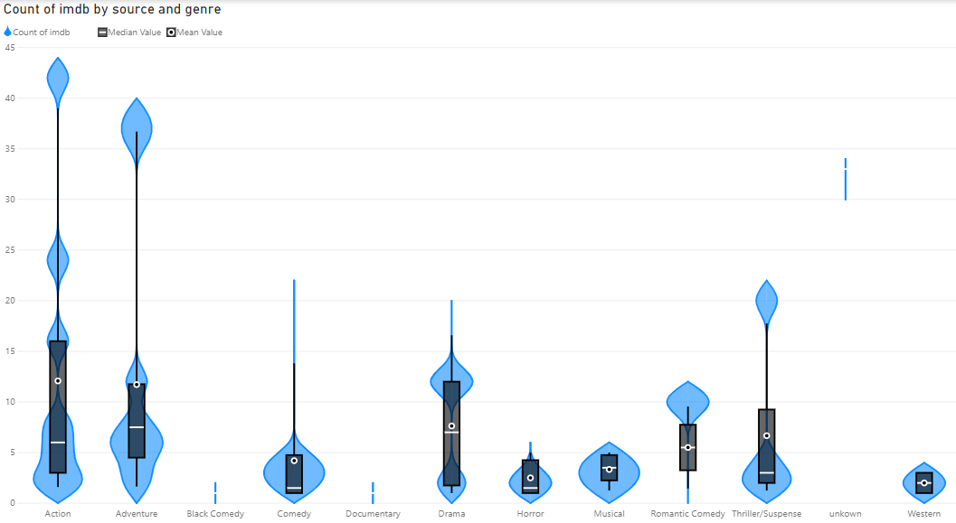
Box Plot: IMDb ratings by genre and source.

Slide 16
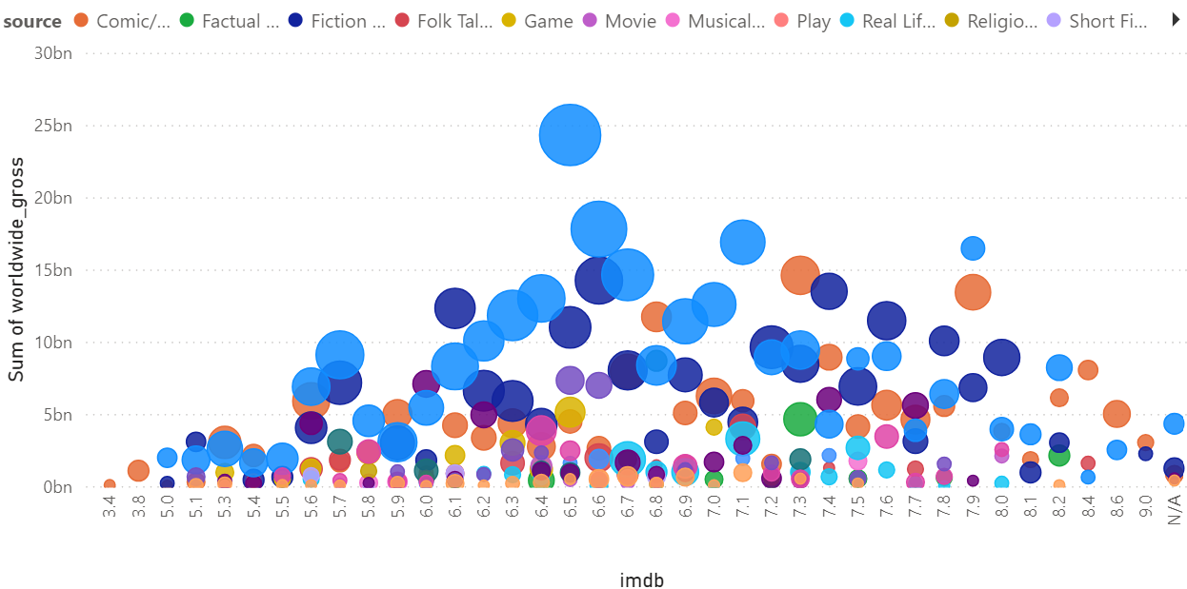
Bubble Charts: Movie distribution by genre, source, and rating.

Slide 17
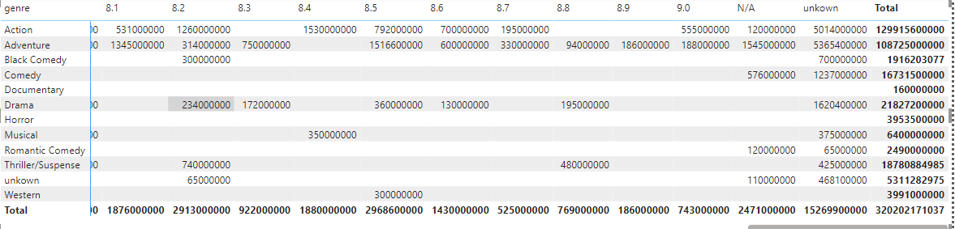
Table for Genre and Imdb ratings with values for Budget.

Slide 18
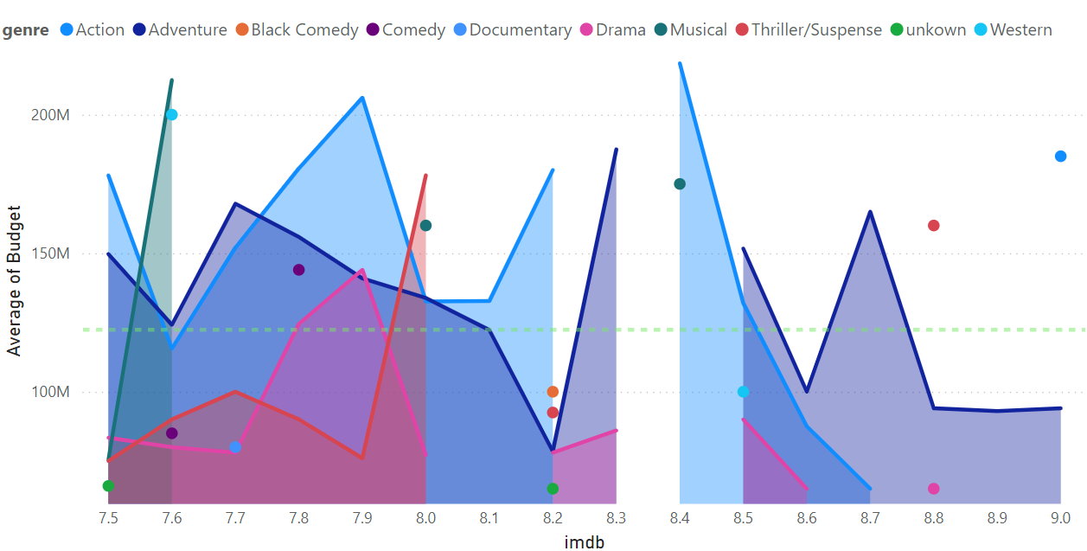
Graph for Genre and Imdb ratings with values for Budget.

Slide 19
Key Findings from the Analysis
Key findings include a strong correlation between genre and IMDb ratings, regional performance insights, and the ranking of top production companies, highlighting trends in the movie industry.
Genre Correlation: Drama correlates highly with IMDb ratings, while adventure links to higher profits.
IMDb Ratings: Most movies fall within the 6-7 IMDb rating range.
Regional Performance: Action movies perform best in China; China and the UK lead in live-action and animation.
Top Production Companies: Walt Disney, Warner Bros, Marvel Studios, Universal Pictures, Paramount, and DreamWorks rank as global leaders.
Genre & Source Performance: Action is the top genre, followed by adventure, with original screenplays as the leading source.
Action Movies have the highest Average Budgets and Adventure genre movies have average budgets around $125M.

Slide 20
Challenges Encountered
Challenges included developing a bot for dynamic pages, writing precise XPaths, using multiple tabs in Selenium, extracting country performance data, and handling financial data anomalies, which were all addressed during the project.
Developing a bot to handle dynamic pages and navigate complex HTML.
Writing precise XPaths for elements without clear indexing.
Using multiple tabs in Selenium for data collection.
Extracting country performance from charts with regex.
Handling "$0" values in financial data with regex and predictive imputation.
Training Random Forest Model for Missing Values.
Plotting Correlation Matrix including categorical variable.

